Slide 1
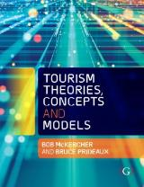

Chapter 15: Climate Change, Resilience and Transition to a Carbon Neutral Economy

Slide 2
Learning Objectives
Describe the role the Intergovernmental Panel on Climate Change (IPCC) plays in discussing climate change
Discuss whether tourism is a victim, winner or loser in climate change
Analyse tourism’s contribution to climate change
Discuss and analyse the concept of resilience as it relates to tourism
Identify various models for tourism and climate change and/or resilience

Slide 3
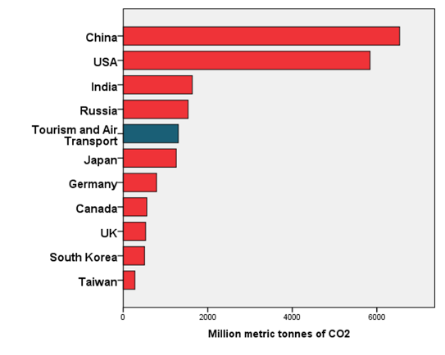
Then came climate change
Tourism is unique in that it is a major contributor of greenhouse gases (GHG) and a significant victim of changing climate
If tourism (including air transport) was a country, it would be the 5th largest contributor of GHG

Slide 4
Tourism is a Contributor
Tourism contributes about five percent of total CO₂ emissions and up to 14% of all emissions when other greenhouse gases are considered (UNWTO-UNEP-UNWTO, 2008).
Air transport accounts for a disproportionately large three-quarters of this amount.
  In Europe, 11% of tourist movements are by air, yet air travel contributes 46% of tourism transport related emissions (UNWTO, 2008).
Flights of less than 500 km have the highest emission factors per capita,
Long-haul travel accounts for only two percent of all trips but contributes 17% of global emissions (Simpson et al., 2008).
Airborne emissions may be between 1.9 and 5.1 times more harmful than surface-based emissions

Slide 5
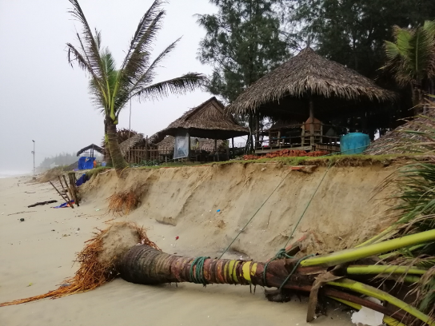
Tourism as a Victim?
Sea level rise could damage beach resorts
56% of existing Swiss ski resorts unviable
Shift of tourist destinations towards higher latitudes and altitudes
Tourists may stay closer to home
Adverse economic consequences for small island nations
Reef dependent destinations at risk
Some places may disappear
Carbon taxes and other disincentives?
Photograph by McKercher

Slide 6
Intergovernmental Panel on Climate Change (IPCC) modelling
IPPC was established in 1988 as a joint initiative of the World Meteorological Organization (WMO) and the United Nations Environment Program (UNEP)
Objective of providing policy makers with regular scientific assessments of the implications of climate change
Apart from regular assessment reports, the IPCC also produces special reports on issues that are of concern to member countries and methodology reports that outline guidelines for developing greenhouse gas inventories
The methodology is based on the synthesis of peer reviewed publications as well as appropriately documented industry publications by a panel of acknowledged academic experts.
  Based on review, not the commissioning of new research
  Number of reviewers may be several hundred

Slide 7
Need to engage in more than simple descriptive works
Model development such as this model on climate change and coral bleaching which combines science and social science to identify impacts

Slide 8
Resilience
Climate change will create significant disruption in the tourism industry in future decades
How will the tourism system cope?
The ability to absorb and adapt to change to ensure ongoing economic and system functioning is an outcome of the level of social and economic resilience
Is tourism resilient?
Resilience - systems do not evolve in a linear fashion but according to a cycle, or loop; that the phases of the cycle roughly repeat, but the characteristics of each stage at different iterations are not necessarily identical; that the characteristics and the speed of recovery from a destabilizing event

Slide 9
Transition to a carbon-neutral economy
The need to reduce and eventually eliminate greenhouse gas emissions through transitioning to a carbon-neutral production lies at the heart of solving the problems caused by climate change
Transition to carbon neutrality will require radical changes to the linear economic production (take, make then dispose) that underpins resource use in the current neoliberal economic model
Require a switch on a global scale to a new economy that will emphasise recycling, renewable energy and regenerative farming

Slide 10
The circular economy model
Underlying principle is better management of global resources
Based on an approach to economic production where the ‘take’ element of resource use is replaced by ‘reuse’ of resources through recycling, reuse, sharing and remanufacturing to create a closed-loop that minimises the use of new resources and reduces or eliminates pollution, waste and emission of carbon
Recognises that the current system of resource use is a major generator of GHGs and responsible for unsustainable use of both renewable and non-renewable resources

Slide 11
Degrowth
Degrowth is a philosophical world view that emerged from fears that the current linear production system will deplete non-renewable resources, accelerate industrialization, cause continuing deterioration of the global environment and lead to socio-economic collapse
Calls for drastic reduction in consumption and production
May be used as strategy to overcome some of the impacts of climate change
Central idea of degrowth is an emphasis on: quality of life rather than quantity of consumption; structural transition to service-based activities by downscaling production and consumption; investment in ecological assets; and changes in worktime as a mechanism to achieve economic stabilisation

Slide 12
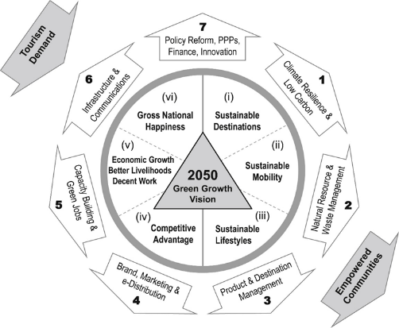
The green economy
low carbon, resource efficient and socially inclusive
needs a holistic approach that requires integration of social inclusiveness and the environment into economic thinking, based on the establishment of a development path that understands that natural capital is a critical economic assert and public benefit
Source: Law, De Lacy, Lipman and Jiang (2016)

